Slide 1

MACHINE LEARNING
UNIT - IV
NEURAL NETWORKS

Slide 2

PERCEPTRON
Definition:
A perceptron is the basic processing element of neural networks.
Inputs can come from the environment or other perceptrons.
Weights and Output:
Each input 𝑥𝑗∈𝑅x j​ ∈R has an associated weight 𝑤𝑗∈𝑅w j​ ∈R.
Output 𝑦y is a weighted sum of the inputs:
Linear Fit:
With 𝑑=1d=1:
interpretable as a line with slope 𝑤w and intercept
For 𝑑>1d>1:
The perceptron defines a hyperplane for multivariate linear fitting.

Slide 3
MULTILAYER PERCEPTRON
Classification:
Divides the input space into two half-spaces:
Positive half-space (𝑦>0y>0) and negative half-space (𝑦<0y<0).
Implements linear discriminant function by checking the sign of 𝑦.
Threshold Function:
The threshold function 𝑠(⋅) is used to classify the output into binary classes.
K-Class Classification:
For 𝐾-class classification:
Use 𝐾 perceptrons with weight matrix 𝑊 of size 𝐾×(𝑑+1).
Outputs 𝑦𝑖,𝑖=1,...,𝐾, are weighted sums of inputs 𝑥𝑗.
Softmax for Posterior Probabilities:
The softmax function is used when posterior probabilities or risk calculations are required.

Slide 4
MULTILAYER PERCEPTRON
Neural Network Implementation:
A perceptron network:
First stage: Computes weighted sums (linear transformation).
Second stage: Applies softmax for classification or regression.
Can also perform dimensionality reduction if 𝐾<𝑑K<d.
Applications:
Linear regression, classification, and dimensionality reduction.
K-parallel perceptrons are used for multiclass classification problems.

Slide 5
MULTI-LAYER PERCEPTRON
1. Definition:
MLP, or Multi-Layer Perceptron, consists of fully connected dense layers that transform inputs of any dimension to desired outputs.
It is a type of neural network with multiple layers, connecting neurons such that outputs of some neurons act as inputs for others.
2. Structure:
Input Layer: Each input corresponds to one node.
Hidden Layer(s): Can have any number of layers and nodes. Each hidden layer processes inputs and passes the results to the next layer.
Output Layer: Contains nodes corresponding to the outputs.Nodes in the input layer forward their outputs to all nodes in the hidden layer, and hidden layers process and pass outputs to subsequent layers.

Slide 6

MULTI-LAYER PERCEPTRON
3. Activation Function:
Nodes typically use a sigmoid activation function, which maps real-valued inputs to values between 0 and 1.
Sigmoid formula:
4. Limitations of Single-Layer Perceptrons:
Can only approximate linear functions of inputs.
Cannot solve nonlinear problems (e.g., XOR problem).
Ineffective for nonlinear regression.
5. Advantages of MLP:
Nonlinear Discriminants: MLP can classify data points that are not linearly separable.
Nonlinear Regression: Capable of approximating nonlinear functions.

Slide 7
MULTI-LAYER PERCEPTRON
6. Examples:
XOR Problem: A single-layer perceptron cannot solve the XOR problem because it is not linearly separable.
MLP with two hidden units can solve XOR by implementing two AND operations, with an OR operation in the output.
7. Generalization:
MLP can include multiple hidden layers, each performing nonlinear transformations of inputs from the previous layer.
Supports computation of complex functions and relationships between inputs and outputs.

Slide 8
MULTI-LAYER PERCEPTRON
8. Key Elements in MLP:
Inputs (xj): Represented as 𝑥𝑗,=0,...,𝑑
Hidden Units (zh): Represented as where 𝐻 is the number of hidden units.
represents the hidden layer bias.
Outputs (yi): Represented as 𝑦𝑖,𝑖=1,...,𝐾
Weights (𝑤ℎ𝑗, 𝑣𝑖ℎ):​
Weights between input and hidden layers.
𝑣𝑖ℎ​ : Weights between hidden and output layers.
9.Flexibility:
MLP is not limited to one hidden layer and can include additional layers for more complex functions of inputs.

Slide 9
ACTIVATION FUNCTIONS IN NEURAL NETWORKS
1. Definition and Inspiration:
An Artificial Neural Network (ANN) is an information-processing system inspired by the brain.
Like humans, ANNs learn through imitation via a learning process that adjusts the connections (synapses) between neurons.
2. Learning Mechanism:
ANNs adapt for specific tasks like pattern recognition or data classification by modifying the interconnections between neurons based on learning.
3. Design Decision:
Choosing the right activation function for the input layer, hidden layer, and output layer is a
critical part of designing a neural network.
4.Neurons in Neural Networks:
Components: Neurons work with weights, biases, and an activation function.
Learning Process: Weights and biases are updated based on the output error using backpropagation.

Slide 10
NEURAL NETWORK COMPONENTS
1. Layers in a Neural Network :
Input Layer :
- Accepts data and forwards it to the network.
- No calculations are performed; nodes transmit raw features to the hidden layers.
Hidden Layer :
- Processes input data from the input layer.
- Performs transformations and generates automatic features.
- Provides neural networks with their complexity and high performance.
- Can consist of one or multiple layers.
Output Layer :
- Delivers the network's final result to the outside world.
- Provides the solution to the problem after processing the input data.

Slide 11
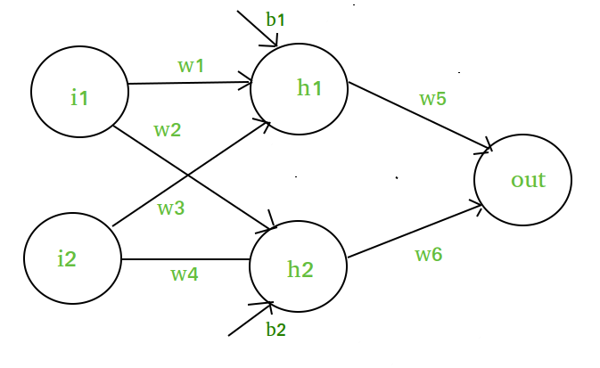
MATHEMATICAL PROOF OF NEED OF NON-LINEARITY IN NEURAL NETWORKS
Network Structure:
1. Input Layer: Two inputs
2. Hidden Layer: One neuron ​
​.
3. Output Layer: One output neuron.

Slide 12

MATHEMATICAL MODEL WITHOUT NON-LINEARITY
Hidden Layer Calculation:
The input to the hidden neuron h1h_1h1​ is calculated as a weighted sum of the inputs plus a bias:
Output Layer Calculation:
The output neuron is then a weighted sum of the hidden neuron’s output plus a bias:
If h1​​ were directly the output of (no activation function applied, i.e.,
then substituting h1h1​ in the output equation yields:
This shows that the output neuron is still a linear combination of the inputs
Thus, the entire network, despite having multiple layers and weights, effectively performs a linear transformation, equivalent to a single-layer perceptron.

Slide 13
LINEAR ACTIVATION FUNCTIONS
1. Linear Activation Function:
Linear Activation Function resembles straight line define by y=x. No matter how many layers the neural network contains, if they all use linear activation functions, the output is a linear combination of the input.
The range of the output spans from (−∞ to +∞)
Linear activation function is used at just one place i.e. output layer.
Using linear activation across all layers makes the network’s ability to learn complex patterns limited.
Linear activation functions are useful for specific tasks but must be combined with non-linear functions to enhance the neural network’s learning and predictive capabilities.

Slide 14
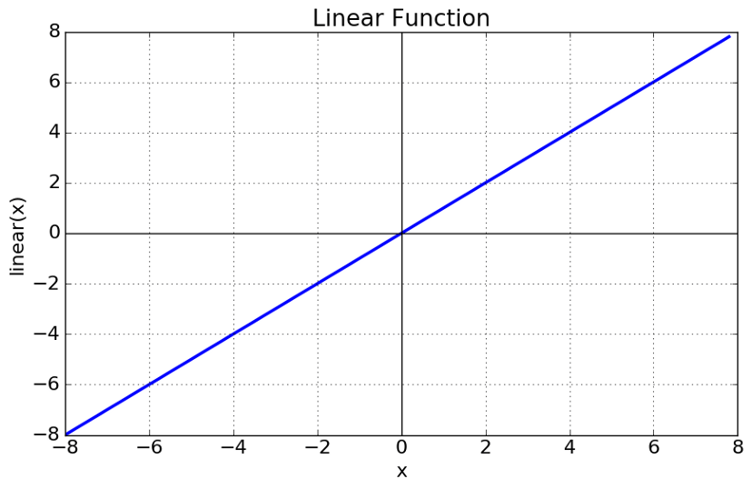
LINEAR ACTIVATION FUNCTIONS

Slide 15

NON-LINEAR ACTIVATION FUNCTIONS
1. Sigmoid Function :
Sigmoid Activation Function is characterized by ‘S’ shape. It is mathematically defined as ​.
This formula ensures a smooth and continuous output that is essential for gradient-based optimization methods.
It allows neural networks to handle and model complex patterns that linear equations cannot.
The output ranges between 0 and 1, hence useful for binary classification.
The function exhibits a steep gradient when x values are between -2 and 2. This sensitivity means that small changes in input x can cause significant changes in output y, which is critical during the training process.

Slide 16
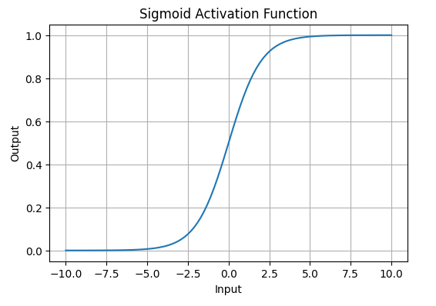
NON-LINEAR ACTIVATION FUNCTIONS

Slide 17

NON-LINEAR ACTIVATION FUNCTIONS
2. Tanh Activation Function
Tanh function or hyperbolic tangent function, is a shifted version of the sigmoid, allowing it to stretch across the y-axis. It is defined as:
Alternatively, it can be expressed using the sigmoid function:
Value Range: Outputs values from -1 to +1.
Non-linear: Enables modeling of complex data patterns.
Use in Hidden Layers: Commonly used in hidden layers due to its zero-centered output, facilitating easier learning for subsequent layers.

Slide 18
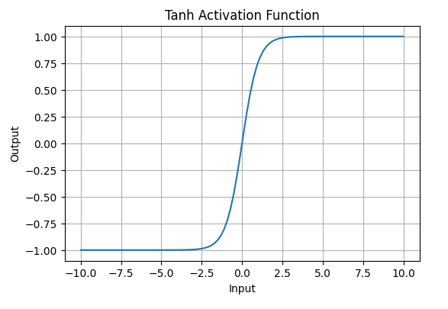
NON-LINEAR ACTIVATION FUNCTIONS

Slide 19
NON-LINEAR ACTIVATION FUNCTIONS
3. ReLU (Rectified Linear Unit) Function :
ReLU Function is defined by A(x)=max⁡(0,x)A(x)=max(0,x), this means that if the input x is positive, ReLU returns x, if the input is negative, it returns 0.
Value Range:
[0,∞)[0,∞), meaning the function only outputs non-negative values.
Nature:
It is a non-linear activation function, allowing neural networks to learn complex patterns and making backpropagation more efficient.
Advantage over other Activation:
ReLU is less computationally expensive than tanh and sigmoid because it involves simpler mathematical operations. At a time only a few neurons are activated making the network sparse making it efficient and easy for computation.

Slide 20
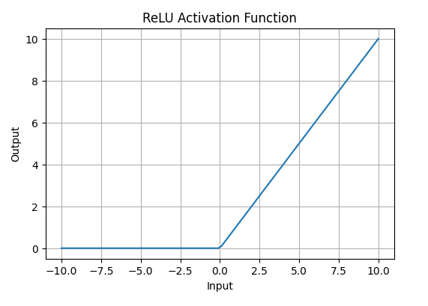
NON-LINEAR ACTIVATION FUNCTIONS

Slide 21
RELU (RECTIFIED LINEAR UNIT) FUNCTION
3. Exponential Linear Units
Softmax Function:
Softmax Function is designed to handle multi-class classification problems. It transforms raw output scores from a neural network into probabilities. It works by squashing the output values of each class into the range of 0 to 1, while ensuring that the sum of all probabilities equals 1.
Softmax is a non-linear activation function.
The Softmax function ensures that each class is assigned a probability, helping to identify which class the input belongs to.

Slide 22
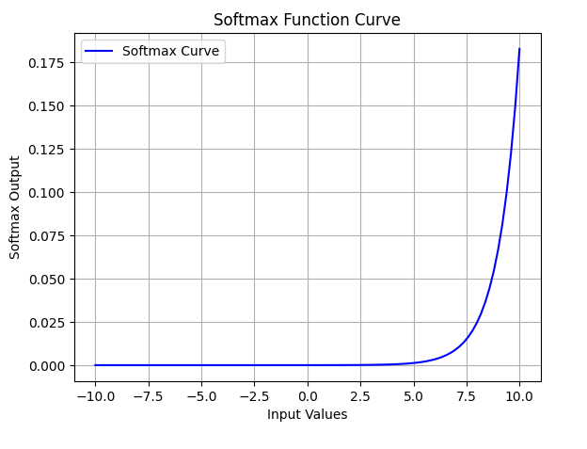
EXPONENTIAL LINEAR UNITS

Slide 23
SOFTPLUS FUNCTION
2. SoftPlus Function:
Softplus function is defined mathematically as: A(x)=log⁡(1+ex)A(x)=log(1+ex). This equation ensures that the output is always positive and differentiable at all points, which is an advantage over the traditional ReLU function.
Nature: The Softplus function is non-linear.
Range: The function outputs values in the range (0,∞)(0,∞), similar to ReLU, but without the hard zero threshold that ReLU has.
Smoothness: Softplus is a smooth, continuous function, meaning it avoids the sharp discontinuities of ReLU, which can sometimes lead to problems during optimization.

Slide 24
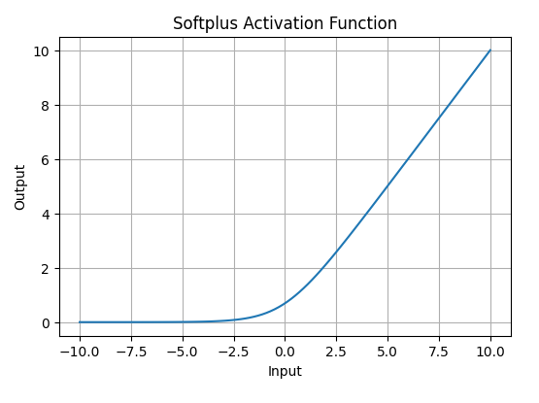
DECISION TREE

Slide 25
IMPACT OF ACTIVATION FUNCTIONS ON MODEL PERFORMANCE
The choice of activation function has a direct impact on the performance of a neural network in several ways:
Convergence Speed:
Functions like ReLU allow faster training by avoiding the vanishing gradient problem, while Sigmoid and Tanh can slow down convergence in deep networks.
Gradient Flow:
Activation functions like ReLU ensure better gradient flow, helping deeper layers learn effectively. In contrast, Sigmoid can lead to small gradients, hindering learning in deep layers.
Model Complexity:
Activation functions like Softmax allow the model to handle complex multi-class problems, whereas simpler functions like ReLU or Leaky ReLU are used for basic layers.

Slide 26
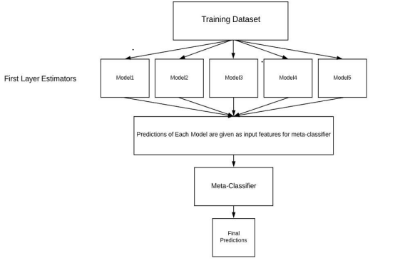
DECISION TREE
Level-1 Prediction: The meta-model learns how to best combine the predictions of the base models and is trained on different predictions made by individual base models, i.e., data not used to train base models are fed to
meta-model, predictions are made, and these predictions, along with the expected outputs, provide the input and output pairs of the training dataset used to fit the meta-model

Slide 27
DECISION TREE
Steps to implement Stacking models:
o Split training data sets into n-folds using the Repeated Stratified KFold as this is the most common approach to preparing training datasets for metamodels.
o Base model is fitted with the first fold, which is n-1, and it will make predictions for nth folds.
o The prediction made in the above step is added to the x1_train list.
o Repeat steps 2 & 3 for remaining n-1folds, so it will give x1_train array of size n.
o Model is trained on all the n parts, which will make predictions for the sample data.
o Add this prediction to the y1_test list.
o In the same way, we can find x2_train, y2_test, x3_train, and y3_test by using
Model 2 and 3 for training, respectively, to get Level 2 predictions.
o Now train the Meta model on level 1 prediction, where these predictions will
be used as features for the model (refer Figure 4.3).
o Meta learners can now be used to make a prediction on test data in the stacking model

Slide 28
UNSUPERVISED LEARNING
Unsupervised learning is a type of machine learning in which models are trained using unlabeled dataset and are allowed to act on that data without any supervision.
Clustering
• Clustering or cluster analysis is a machine learning technique, which groups
the unlabeled dataset.
• It is "A way of grouping the data points into different clusters, consisting of
similar data points. The objects with the possible similarities remain in a
group that has less or no similarities with another group.“
• Clustering involves dividing data points into multiple clusters of similar values.
• Cluster is a group of objects that belongs to the same class

Slide 29
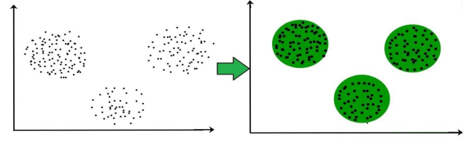
UNSUPERVISED LEARNING
Clustering is a process of partitioning a set of data in a meaningful subclass as shown in fig.

Slide 30
UNSUPERVISED LEARNING
Common uses of this technique are:
Market Segmentation
Statistical data analysis
Social network analysis
Image segmentation
Anomaly detection, etc.
Types of Clustering Methods
Hard clustering (datapoint belongs to only one group)
Soft Clustering (data points can belong to another group also).

Slide 31
UNSUPERVISED LEARNING
Main clustering methods used in Machine learning:
Partitioning Clustering
Density-Based Clustering
Distribution Model-Based Clustering
Hierarchical Clustering
Fuzzy Clustering
Partitioning Clustering
It is a type of clustering that divides the data into non -hierarchical
groups.
It is also known as the centroid-based method.
Most common example of partitioning clustering is the K-Means clustering algorithm

Slide 32
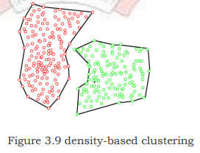
UNSUPERVISED LEARNING
Density-Based Clustering
• The density-based clustering method connects the highly-dense areas into clusters, and the arbitrarily shaped distributions are formed as long as the dense region can be connected.
• This algorithm does it by identifying different clusters in the dataset and connects the areas of high densities into clusters.
• The dense areas in data space are divided from each other by sparser areas

Slide 33
UNSUPERVISED LEARNING
Distribution Model-Based Clustering :
• In the distribution model-based clustering method, the data is divided based on the probability of how a dataset belongs to a particular distribution.
The grouping is done by assuming some distributions commonly Gaussian Distribution.
• The example of this type is the Expectation-Maximization Clustering
algorithm that uses Gaussian Mixture Models (GMM) as shown in
In this technique, the dataset is divided into clusters to create a tree - like structure, which is also called a dendrogram.
The observations or any number of clusters can be selected by cutting the tree at the correct level.
The most common example of this meth od is the Agglomerative
Hierarchical algorithm

Slide 34
UNSUPERVISED LEARNING
Common uses of this technique are:
Market Segmentation
Statistical data analysis
Social network analysis
Image segmentation
Anomaly detection, etc.
Types of Clustering Methods
Hard clustering (datapoint belongs to only one group)
Soft Clustering (data points can belong to another group also).

Slide 35
UNSUPERVISED LEARNING
Main clustering methods used in Machine learning:
Partitioning Clustering
Density-Based Clustering
Distribution Model-Based Clustering
Hierarchical Clustering
Fuzzy Clustering
Partitioning Clustering
It is a type of clustering that divides the data into non –hierarchical groups.
It is also known as the centroid-based method.
The most common example of partitioning clustering is the K-MeansClustering algorithm

Slide 36
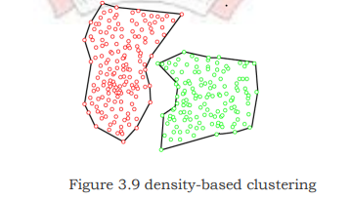
UNSUPERVISED LEARNING
Density-Based Clustering
• The density-based clustering method connects the highly-dense areas
into clusters, and the arbitrarily shaped distributions are formed as
long as the dense region can be connected.
• This algorithm does it by identifying different clusters in the dataset
and connects the areas of high densities into clusters.
• The dense areas in data space are divided from each other by sparser
areas

Slide 37
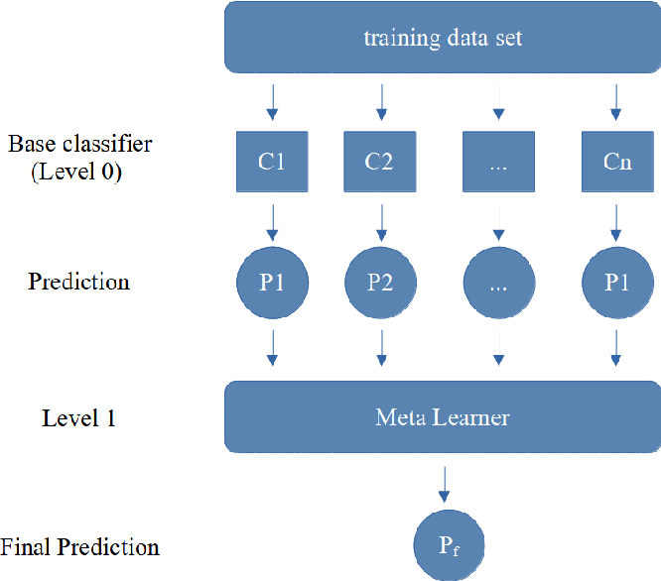
UNSUPERVISED LEARNING
Distribution Model-Based Clustering
• In the distribution model-based clustering method, the data is divided based on the
probability of how a dataset belongs to a particular distribution.
The grouping is done by assuming some distributions commonly .
• The example of this type is the Expectation-Maximization
Clustering algorithm that uses Gaussian Mixture Models shown
• In this technique, the dataset is divided into clusters to
create a tree - like structure, which is also called a dendrogram.
• The observations or any number of clusters can be selected
by cutting tree at the correct level.
• The most common example of this method is the
Agglomerative Hierarchical algorithm

Slide 38
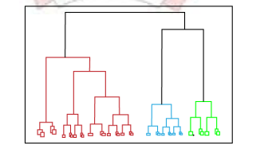
UNSUPERVISED LEARNING
Hierarchical Clustering:
1. Fuzzy Clustering:
Fuzzy clustering is a type of soft method in which a data object
May belong to more than one group or cluster.
• Each dataset has a set of membership coefficients, which
depend on the degree of membership to be in a cluster.
• Fuzzy C-means algorithm is the example of this type of
Clustering sometimes also known as the Fuzzy k-means algorithm.
Clustering Algorithms
• K-Means algorithm • Mean-shift algorithm • Affinity Propagation
• Expectation-Maximization Clustering using GMM • Agglomerative Hierarchical algorithm
• DBSCAN Algorithm-Density-Based Spatial Clustering of Applications with Noise.

Slide 39




UNSUPERVISED LEARNING
Working of K-Means Algorithm :
The working of the K-Means algorithm is explained in the below steps:
1. Choose the value of k and the k initial guesses for the centroids.
2. Compute the distance from each data point to each centroid. In two dimensions, the distance, d, between any two points, (X1, Y1) and (X2, Y2), in the Cartesian plane is typically expressed by using the Euclidean distance measure provided in
3. Compute the centroid, the center of mass, of each newly defined cluster from Step2.
In two dimensions, the centroid (Xc, Yc) of the m points in a k-means cluster is calculated as
follows in
4. Calculate distance d, between pi and q. For a point, pi, at (pi1, pi2, . . . pin), a centroid q, located at (q1, q2, . . . qn), the distance, d, between pi and q, is expressed as
5. Calculate centroid, q. The centroid, q, of a cluster of m points,
(pi1, pi2, . . . pin) , is calculated

Slide 40
INSTANCE BASED LEARNING
Instance based learning:
• The systems that learn the training examples by heart and then generalizes to new instances based on some similarity measure, also called memory-based learning or lazy-learning.
• It is called instance-based because it builds the hypotheses from the training instances.
• It is also known as • When a new instance is encountered, its relationship to the stored examples is examined in order to assign a target function value for the new instance.
• Instance-based methods are sometimes referred to as lazy learning methods because they delay processing until a new instance must be classified.
• Instead of estimating the target function once for the entire instance space, these methods can estimate it locally and differently for each new instance to be classified.
• Some of the instance-based learning algorithms are:
o K Nearest Neighbor (KNN) o Self-Organizing Map (SOM) o Learning
Vector Quantization (LVQ) o Locally Weighted Learning (LWL) o Case Based Reasoning

Slide 41
K-NEAREST NEIGHBOR LEARNING - KNN
o k-Nearest Neighbor Learning - KNN is one of the simplest Machine Learning algorithms based on Supervised Learning technique.
o K-NN algorithm assumes the similarity between the new case/data and available cases and put the new case into the category that is most similar to the available categories.
o K-NN algorithm can be used for Regression as well as for Classification but mostly it is used for the Classification problems.
o K-NN is a non-parametric algorithm, which means it does not make any assumption on underlying data. o It is also called a lazy learner algorithm because it does not learn from
the training set immediately instead it stores the dataset and at the time of classification, it performs an action on the dataset.
o KNN algorithm at the training phase just stores the dataset and when it gets new data, then it classifies that data into a category that is much similar to the new data.

Slide 42
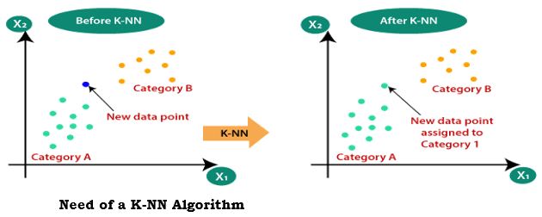
K-NEAREST NEIGHBOR LEARNING - KNN
Suppose there are two categories, i.e., Category A and Category B, and we have a new data point x1, so this data point will lie in which of these categories. To solve this type of problem, we need a K -NN algorithm. With the help of K -NN, we can easily identify the category or class of a particular dataset. Consider the below diagram:

Slide 43
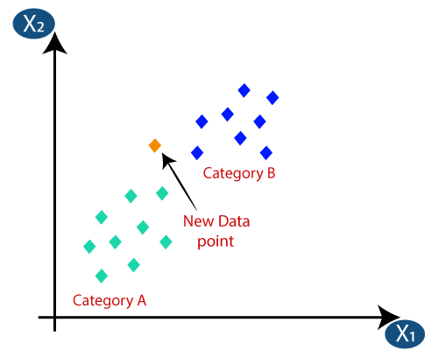
K-NEAREST NEIGHBOR LEARNING - KNN
How does K-NN work?
The K-NN working can be explained on the basis of the below algorithm:
Step-1: Select the number K of the neighbors
Step-2: Calculate the Euclidean distance of K number of neighbors
Step-3: Take the K nearest neighbors as per the calculated Euclidean distance.
Step-4: Among these k neighbors, count the number of the data points in each category.
Step-5: Assign the new data points to that category for which the number of the neighbor is maximum.
Step-6: Our model is ready.
Suppose we have a new data point
and we need to put it in the required
category. Consider the below image:

Slide 44
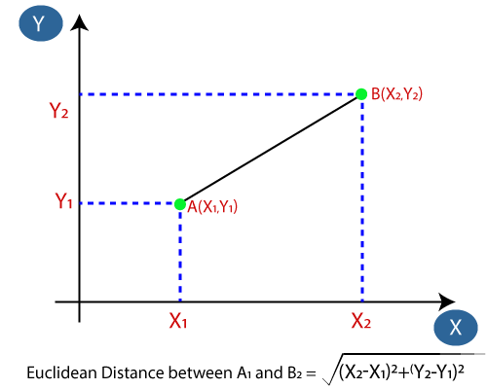
K-NEAREST NEIGHBOR LEARNING - KNN
Firstly, we will choose the number of neighbors, so we will choose the k=5.
Next, we will calculate the Euclidean distance between the data points. The Euclidean distance is the distance between two points, which we have already studied in geometry. It can be calculated as:

Slide 45
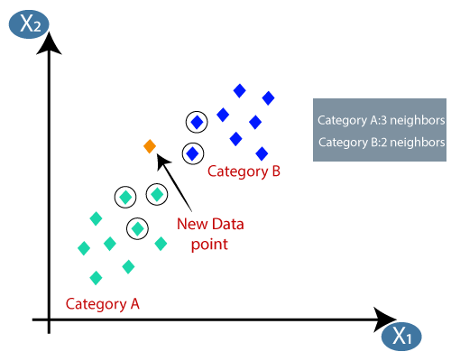
K-NEAREST NEIGHBOR LEARNING - KNN
By calculating the Euclidean distance we got the nearest neighbors, as three nearest neighbors in category A and two nearest neighbors in category B. Consider the below image:

Slide 46
K-NEAREST NEIGHBOR LEARNING - KNN
Advantages of KNN Algorithm:
It is simple to implement.
It is robust to the noisy training data
It can be more effective if the training data is large.
Disadvantages of KNN Algorithm:
Always needs to determine the value of K which may be complex some time.
The computation cost is high because of calculating the distance between the data points for all the training samples.

Slide 47
K-NEAREST NEIGHBOR LEARNING - KNN
Python implementation of the KNN algorithm :
To do the Python implementation of the K-NN algorithm, we will use the same problem and dataset which we have used in Logistic Regression. But here we will improve the performance of the model. Below is the problem description:
Problem for K-NN Algorithm: There is a Car manufacturer company that has manufactured a new SUV car. The company wants to give the ads to the users who are interested in buying that SUV. So for this problem, we have a dataset that contains multiple user's information through the social network. The dataset contains lots of information but the Estimated Salary and Age we will consider for the independent variable and the Purchased variable is for the dependent variable. Below is the dataset:

Slide 48
K-NEAREST NEIGHBOR LEARNING - KNN
Advantages of KNN Algorithm:
It is simple to implement, robust to the noisy training data
It can be more effective if the training data is large.
Disadvantages of KNN Algorithm:
Always needs to determine the value of K which may be complex some time.
The computation cost is high as calculating the distance between the data points for all the training samples.’
Steps to implement the K-NN algorithm:
Data Pre-processing step
Fitting the K-NN algorithm to the Training set
Predicting the test result
Test accuracy of the result(Creation of Confusion matrix)
Visualizing the test set result.

Slide 49
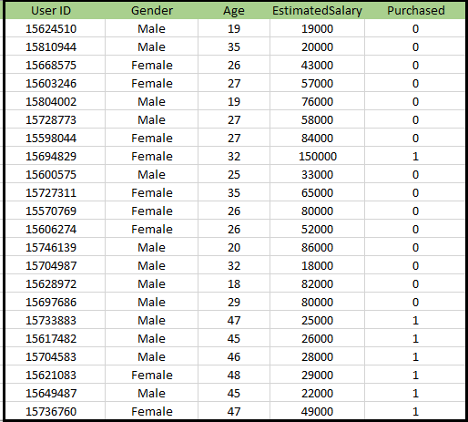
K-NEAREST NEIGHBOR LEARNING - KNN
Test Example:
Gender: Male,
Age: 30, Salary: 60,000
Goal: Predict "Purchased" (0 or 1).
2. Steps in KNN:
Choose K (e.g., 𝐾=5K=5).
Calculate Euclidean distance between test example and all training points.
Find the K closest neighbors.
Count neighbors in each class (Purchased = 0 or 1).
Assign the class with the majority vote.
3. Example Prediction:
Nearest neighbors:
3 (Purchased = 0),
2 (Purchased = 1).
Prediction: Purchased = 0.

Slide 50
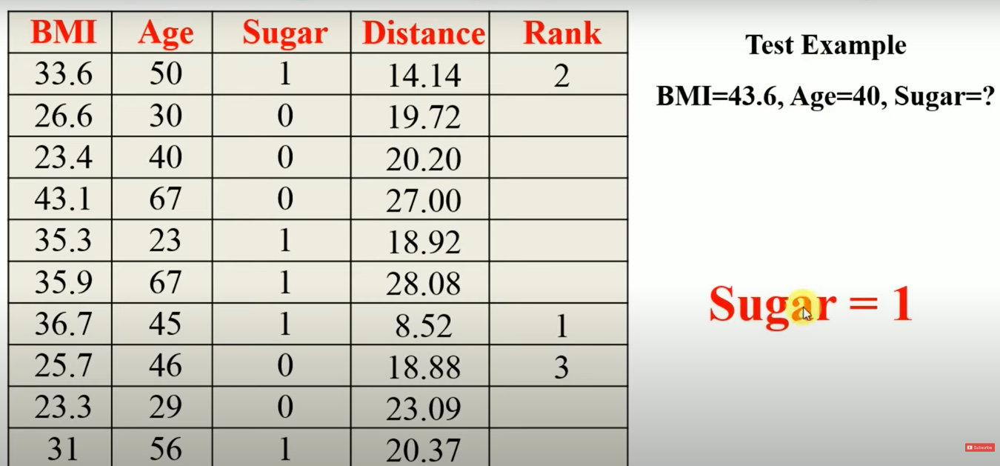
K-NEAREST NEIGHBOR LEARNING - KNN

Slide 51
GAUSSIAN MIXTURE MODEL
Gaussian mixture models (GMMs) are a type of machine learning algorithm.
They are used to classify data into different categories based on the probability distribution.
• Gaussian mixture models can be used in many different areas, including finance, marketing and so much more.
• The Gaussian mixture model is a probabilistic model that assumes all the data points are generated from a mix of Gaussian distributions with unknown parameters.
• A Gaussian mixture model can be used for clustering, which is the task of grouping a set of data points into clusters.
• In general, K-means will be faster and more accurate when the data set is large and the clusters are well-separated. Gaussian mixture models will be more accurate when the data set is small or the clusters are not well separated.
• GMM consists of two parts – mean vectors (μ) & covariance matrices (Σ).

Slide 52

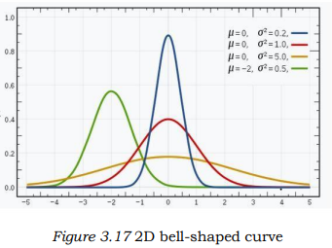
GAUSSIAN MIXTURE MODEL
A Gaussian distribution is defined as a continuous probability distribution that takes on a bell-shaped curve. Another name for Gaussian distribution is the normal distribution
• Gaussian mixture models can handle missing data, whereas K-means cannot.
In the case of two variables, instead of a 2D bell-shaped curve, we will have 3D bell curve
covariance matrix.
• Probability density function for one dimensional space of a Gaussian distribution is given by:
where μ is the mean and
is the variance
• In case of two variables, instead of
a 2D bell-shaped curve, we will have
a 3D bell curve

Slide 53
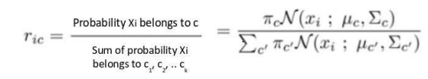
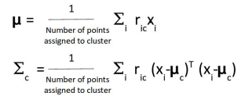
GAUSSIAN MIXTURE MODEL
E-step:
For each point x i, calculate the probability that it belongs to cluster/distribution c 1, c 2, … c k. This is done using the below formula:
This value will be high when the point is
assigned to the right cluster and lower otherwise.
M-Step:
Update Density: Calculate cluster density
as the fraction of points in the cluster out of the total points.
Update Mean and Covariance: Adjust mean and covariance
based on probabilities of points belonging to the cluster
(higher probability = greater influence).

Slide 54
THANK YOU…

